Slide 1
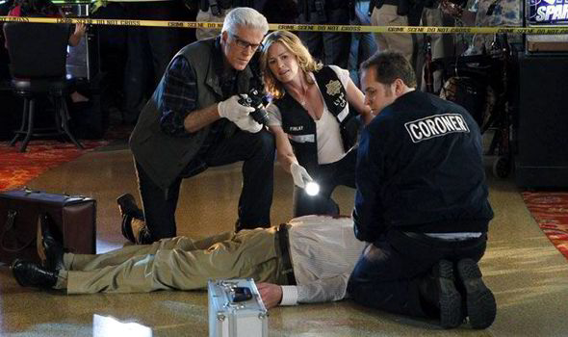
Science and The Detective

Slide 2
Science Application in Criminal Investigation
Science plays a key role in criminal investigation cases; especially cases involving homicide and death. It is through science that investigators can link DNA evidence found in the crime scene to a suspect of crime.
The science used by detectives is known as forensic science and it is essential in the collection, preparation and analysis of evidence; and presentation of scientific findings to court.
Notes:
There are various elements of forensic science which include: Trace Evidence Analysis, Forensic Toxicology, Forensic Psychology, Forensic Podiatry, Forensic Pathology, Forensic Optometry, Forensic Odontology, Forensic Linguistics, Forensic Geology, Forensic Entomology, Forensic Engineering, Forensic DNA Analysis, Forensic Botany, Forensic Archeology, Forensic Anthropology, Digital Forensics, Criminalistics among others

Slide 3
Toxicology of drugs
Toxicology of drugs is the study of how the use of certain drugs may affect the users.
Forensic toxicology of drugs is a test that is usually performed on a body during autopsy to determine whether there are drugs or chemicals that are present in the body fluids and tissues; and to quantify the concentration of drugs, poisons or chemicals present.
Toxicological studies mainly involves the detection, identification, and quantification of hazards resulting from human exposure to chemicals and drugs in smoke, food, and medications.
Notes:
Toxicology generally looks at the effects that chemicals and other physical agents and reagents may have on humans and other living organisms (Eaton & Gilbert, 2008, p11).
There are various types of toxicology which include; Analytical toxicology, Applied toxicology, Clinical toxicology, Veterinary toxicology, Forensic toxicology, Environment toxicology, and Industrial toxicology.
Toxicology also studies the public health aspects of toxic agents in the environment to help in the study and development of novel pharmaceutical products.

Slide 4
Role of a Forensic Pathologist
A Forensic pathologist:
gets involved in the collection of medical evidence like trace evidence and secretions of a dead body in the crime scene.
Performs autopsies to conduct autopsies to prove or rule out the presence of diseases, toxins or injuries that may have led to death.
Refers to history and investigative information on law enforcement relating to the analysis of manner of death.
Notes:
A forensic pathologist is a physician who is trained with special skills on studying and examining the corpses of those who died suddenly or in a violent way. They help determine the specific cause of death (Schuliar & Knudsen, 2012, p165).

Slide 5
Role of a forensic entomologist
Analyzes the magnitude of ante-mortem injuries and the degree of postmortem changes on a cadaver.
Helps in investigation of cause of death in cases where the body contains insects
Uses collected evidence on soil and insects to triangulate and determine the place where a crime took place.
Determines the time of death using the stages of decomposition.
identifies the arthropods associated with a dead body and uses them to conduct an analysis of entomological data essential in the interpretation of insect evidence.
Notes:
Forensic entomology is the study of insect biology as it relates to societal problems that come to the attention of the legal profession and that often must be resolved by legal proceedings (Hart et al., 2008, p39).
It uses insects to collect information related to a crime.
The entomologists conducts research on a cadaver to identify how, when and why death occurred.
There are three types of forensic entomology namely;
Medico-criminal entomology- studies homicides, suicides, neglect or abuse of the young or elderly, and illicit drug use.
Medical entomology- looks at insect bites, stings, and allergic reactions caused by interaction with insects.
Stored product entomology- Gets involved when insects infest stored commodities.
Structural entomology- mainly studies insects that destroy wood.
Veterinary entomology- looks at illegal hunting and poaching.
Evidence gathered by a forensic pathologist is used to explain the progression of changes and causes of injuries or damages.

Slide 6

Roles of a Forensic Toxicologist
Examines body organs, fluids and tissues to determine whether there are any chemicals, poisons or drugs that may have caused death.
Gives witness testimony explaining the investigation results.
Checks and identifies any chemicals used in a crime
Notes:
Forensic toxicologists have the important job of studying and analyzing chemicals to determine the effect they have on the human body. They also study the body in cases of suspected intoxication to determine whether there are any chemicals, drugs or poisons present.
They study drug related deaths like food or alcohol poisoning, deliberate or accidental poisoning, and suicidal poisoning.

Slide 7
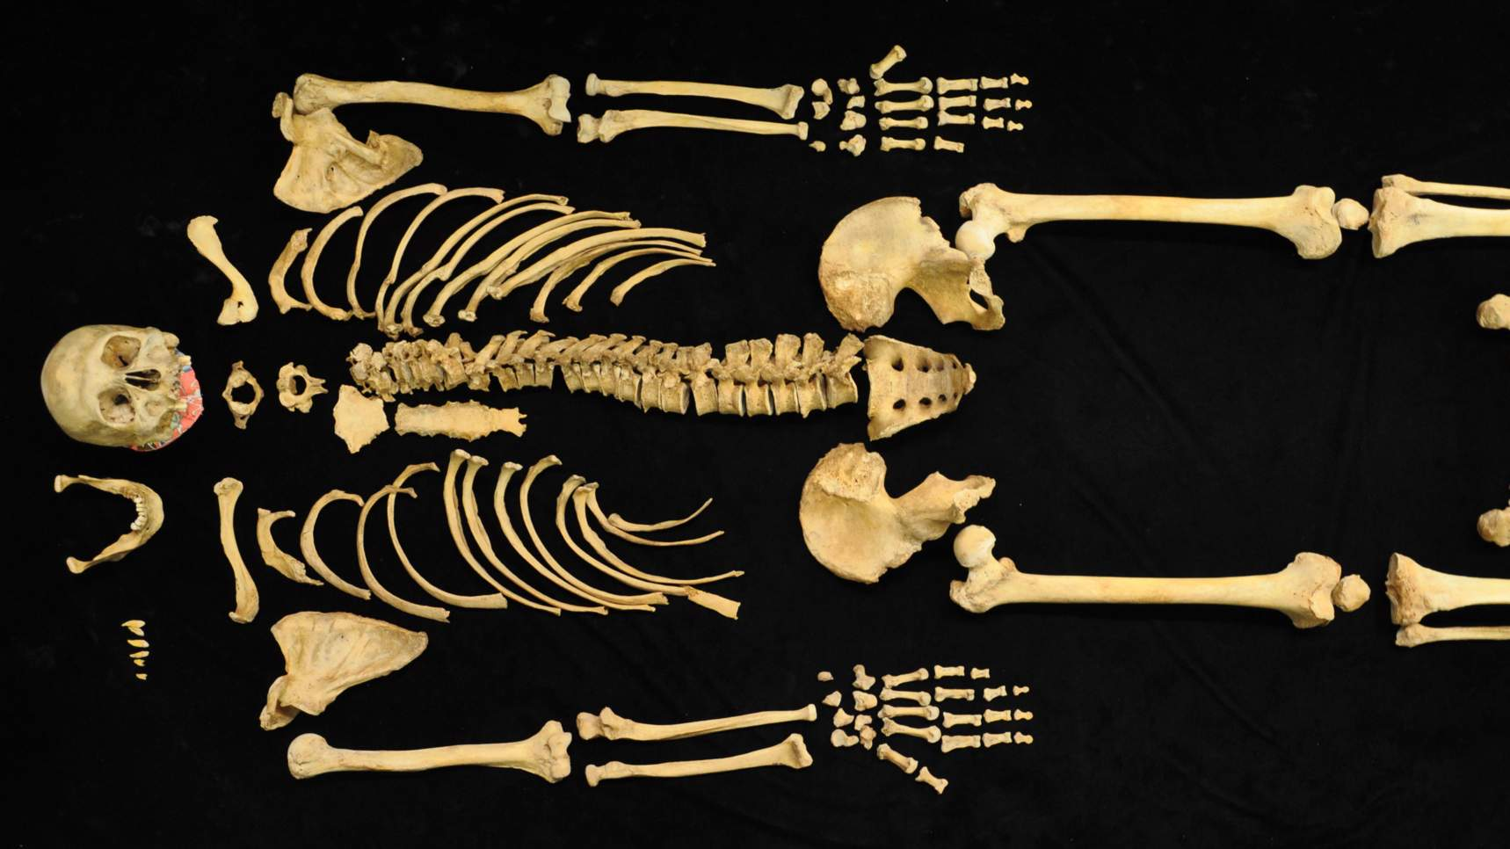
Roles of a Forensic Anthropologist
Inspects decomposed remains for any trauma signs.
Determines the
characteristics
of the victim
Examines skeletal remains and writes reports on findings
Notes:
A forensic anthropologist deals in the study and examination of decomposed remains.
Through the excavation and study of the skeletal, a forensic anthropologist can identify the characteristics of a victim like age, gender and whether the death was caused by an injury (Stanojevich, 2012, p3).

Slide 8
Computer Forensics
Whenever a crime occurs, there is a possibility that a computing device was used in communication, planning or execution of the crime. Computer forensics involves the examination of the computing and digital devices for information and data recovery that may be considered helpful in solving a crime.

Slide 9
Investigative Procedures Involving Computer Forensics
Development of processes and policies to be applied in the investigation.
Assessment of Evidence to be collected to identify exactly what to look for during the investigation.
Search, Acquisition and recording of evidence. Involves the retrieval of sensitive data to be used as evidence
Notes:
Step 1: May include information on how and when the procedure will be conducted. This step also involves obtaining any warrants or authorizations to legalize search or seizure if computing devices.
Step 2: The detectives have to determine the type of evidence to be collected. If the investigation is on murder then they have to specify what evidence like online weapon purchases will be looked for during computer forensics investigations.
Step 3: in this step, extensive documentation is needed before, during, and after the acquisition process; detailed information must be recorded and preserved, including all hardware and software specifications, any systems used in the investigation process, and the systems being investigated

Slide 10
Procedures Involving Computer Forensics cont.
4. Examination of collected evidence to determine relevance and applicability. Tin this step, the evidence is also examined for any signs of tampering. Any information or data that can serve as evidence is secluded from the rest for easy tracing.
5. Documenting evidence and reporting on the findings of the investigation. The investigators must provide records for type of evidence collected, time and place of collection.
Notes:
Step 4:The collected data is analyzed and traced to the source to help in determine whether the case involves a single suspect or other accomplices.
Step 5: All actions related to a particular case should be accounted for in a digital format and saved in properly designated archives. This helps ensure the authenticity of any findings by allowing these cyber security experts to show exactly when, where, and how evidence was recovered. It also allows experts to confirm the validity of evidence by matching the investigator’s digitally recorded documentation to dates and times when this data was accessed by potential suspects via external sources.

Slide 11
How Forensic Scientists can work collectively to solve crimes
Forensic entomologists, pathologists, anthropologists and toxicologists are all specialized in different ways of analyzing victims to identify cause of death and suspects. There are various cases that involve more than one type of evidence and when the forensic analysts collaborate, they can be able to collect more evidence within a short period of time and brainstorm on the research findings in order to develop a strong argument that can stand trial in court.
Notes:
Combining examination of cadavers, drugs, insects, and skeletal can be helpful in identification of evidence that would have been ignored by only one type of forensic analyst.

Slide 12
Reference List
Eaton, D.L. and Gilbert, S.G., 2008. Principles of toxicology. Casarett & Doull’s toxicology: The basic science of poisons, pp.11-43.
Hart, A.J., Whitaker, A.P. and Hall, M.J., 2008. The use of forensic entomology in criminal investigations: how it can be of benefit to SIOs. The Journal of Homicide and Major Incident Investigation, 4(1), pp.37-47.
Schuliar, Y. and Knudsen, P.J.T., 2012. Role of forensic pathologists in mass disasters. Forensic science, medicine, and pathology, 8(2), pp.164-173.
Stanojevich, V., 2012. The role of a forensic anthropologist in a death investigation. Journal of Forensic Research, 3(6), p.3.

